Slide 1
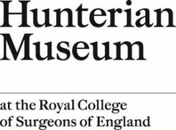
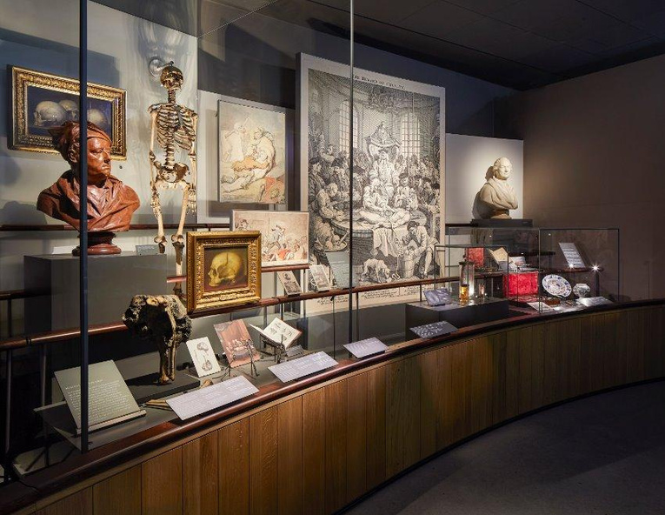
Welcome to the Hunterian Museum

Slide 2
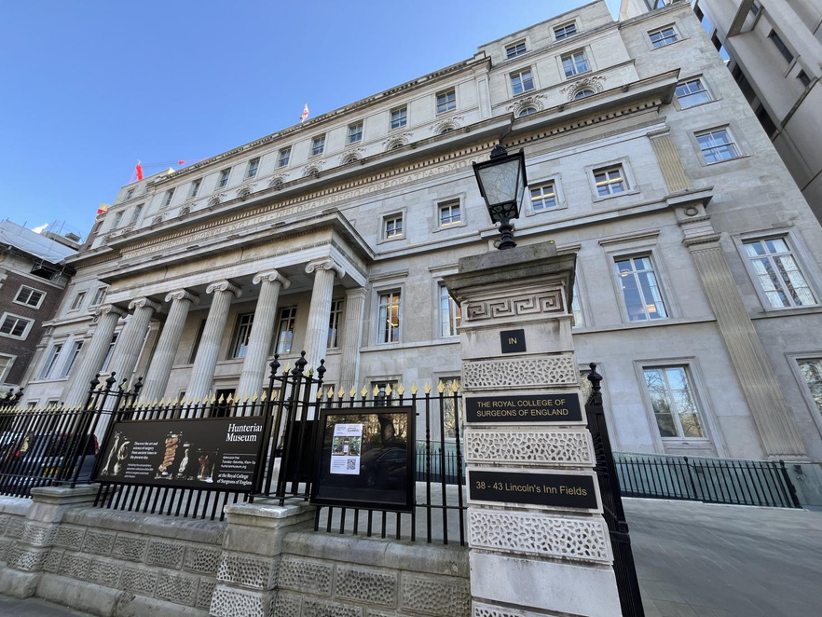
This is the building of the Royal College of Surgeons of England. The Hunterian Museum is on the ground floor of the building.

Slide 3
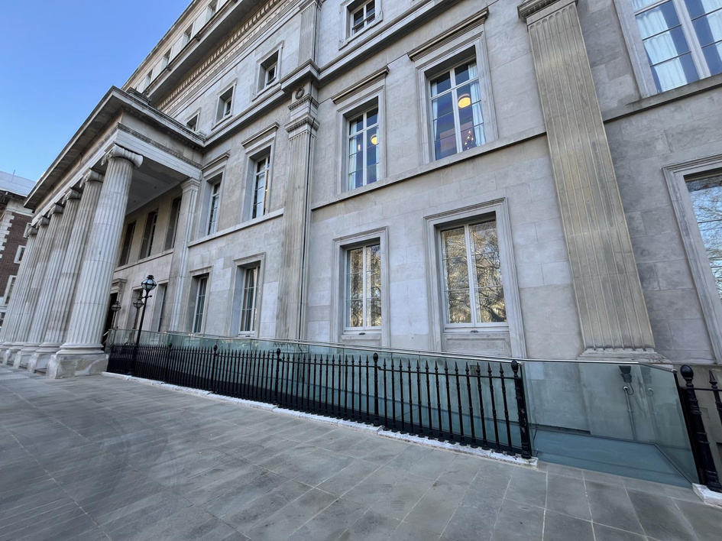
This is the Lincoln’s Inn Fields entrance, with a ramp at the right of the entrance.

Slide 4
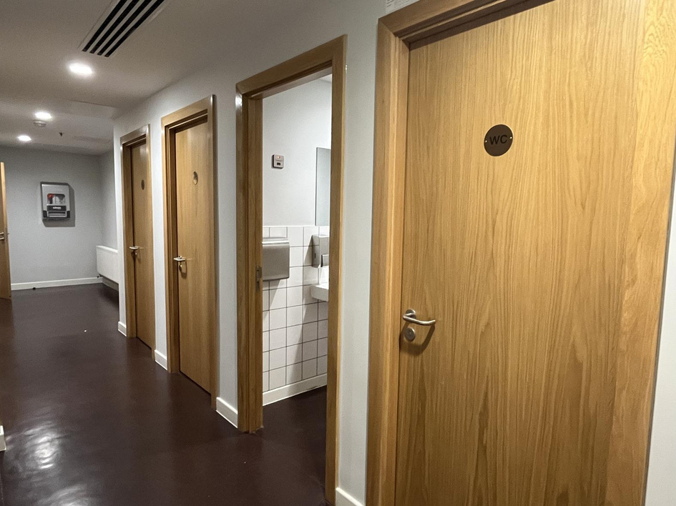
The toilets are on the ground floor, to the left as you enter from Lincoln’s Inn Fields.

Slide 5
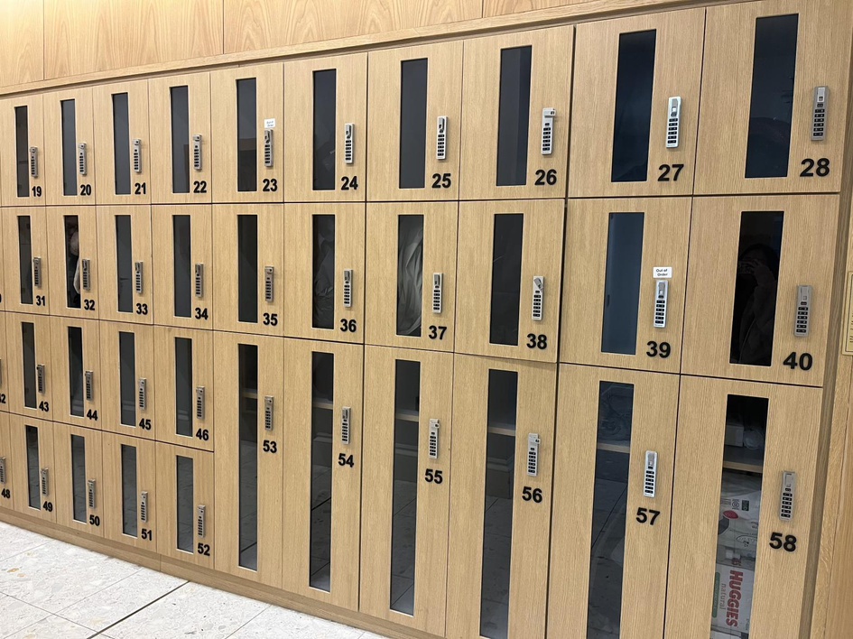
You can leave your bag and coat in the locker.

Slide 6
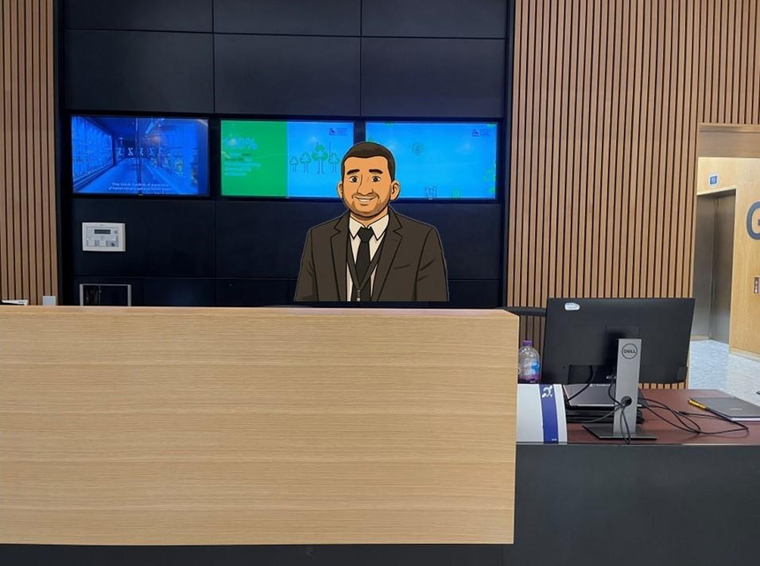
This is the reception desk. The staff can help you if you have any questions.

Slide 7
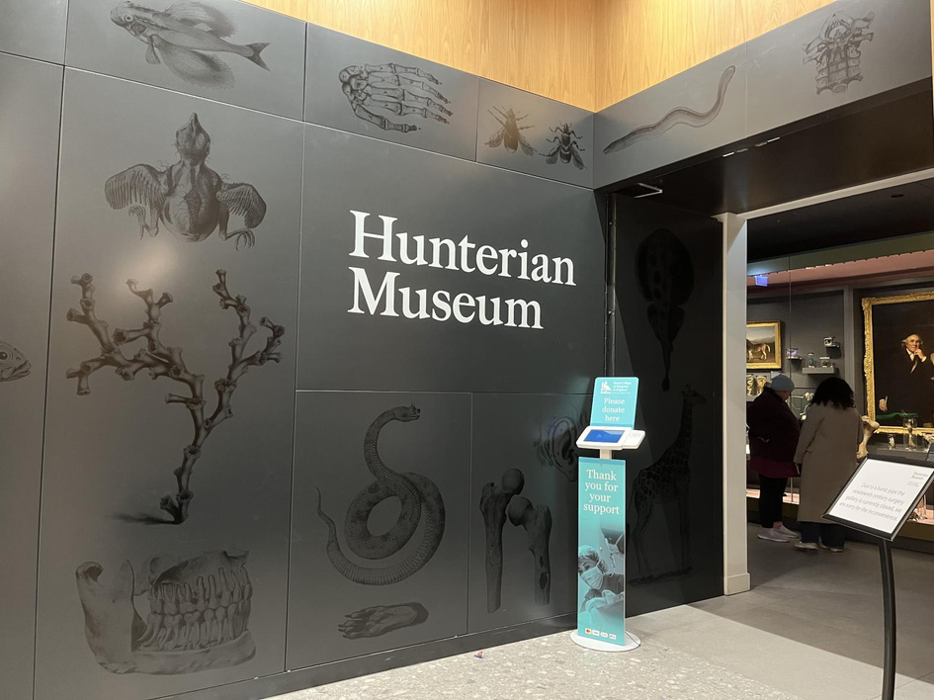
The Hunterian Museum’s entrance is next to the reception desk.

Slide 8
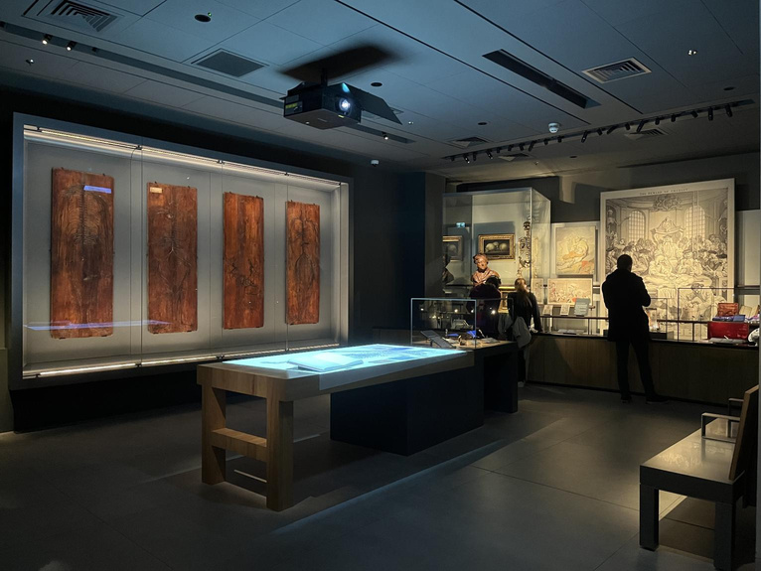
Surgery and Anatomy
This room introduces the development of surgical treatments and anatomical knowledge over time.
There is no natural daylight in the museum in order to protect specimens.

Slide 9
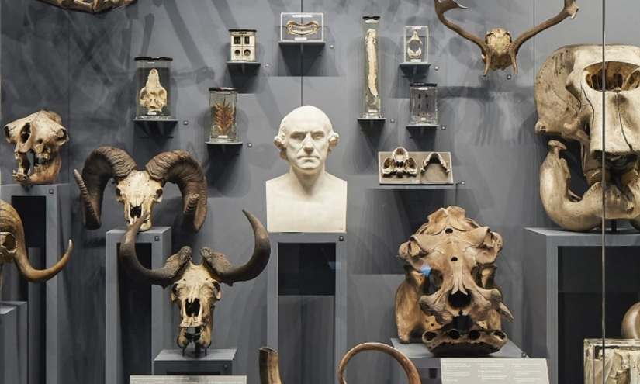


John Hunter – A Curious Mind
This room looks at John Hunter’s curiosity towards the natural world.
You can hear animal sounds in this room: bees, frogs, birds, cows, sheep and roar of a cheetah.

Slide 10
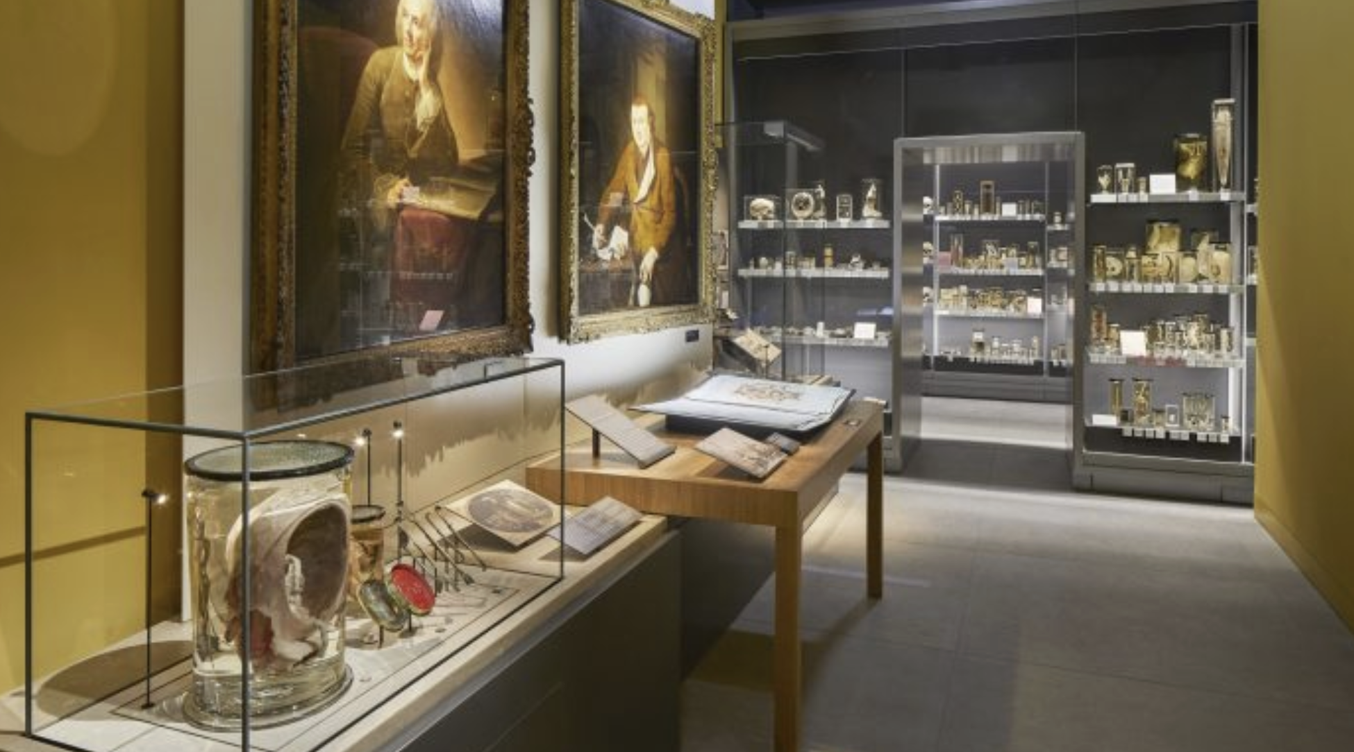
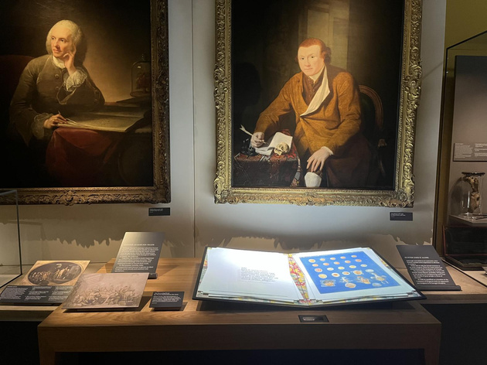
John Hunter – The Making of a Surgeon
This room explores John Hunter’s early career before becoming a surgeon.
You can use the device to hear the conversation between John Hunter and his brother, William.

Slide 11
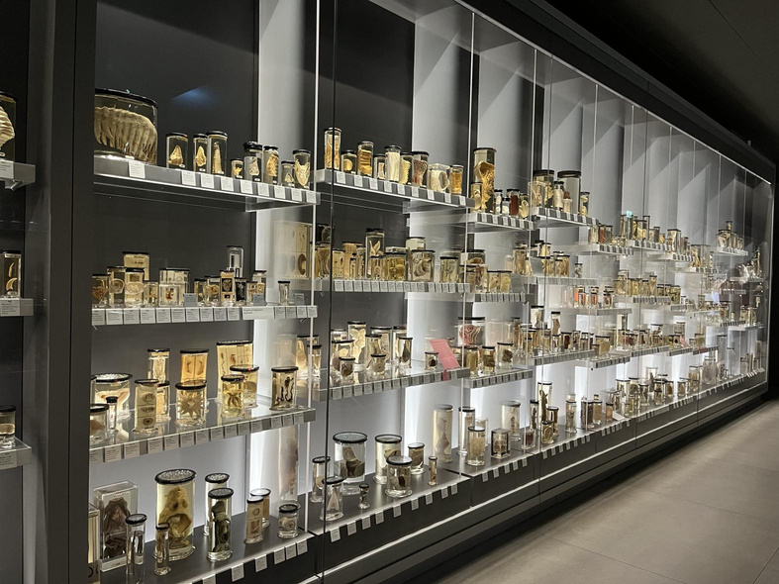
The Long Gallery
This room displays the majority of John Hunter's collection.
You will see many specimens in jars inside the gallery, including animals, insects and human remain.

Slide 12
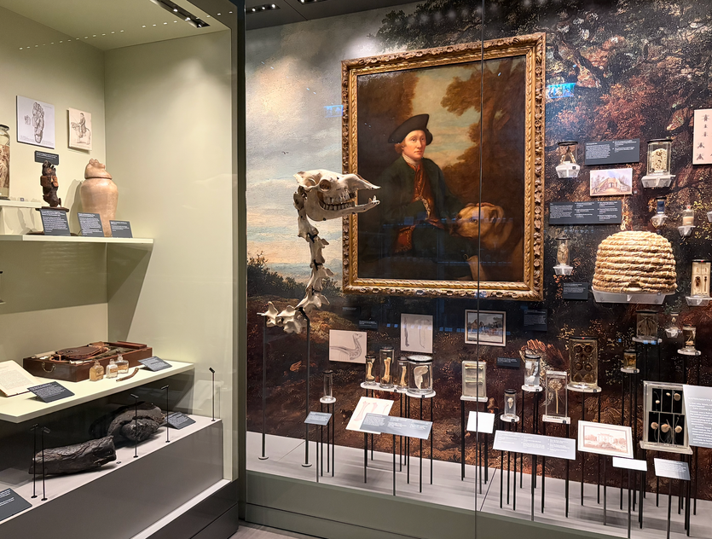

John Hunter – Earl’s Court
By 1765, John bought a small country estate at Earl’s Court.
This room looks at some of the work he carried out there

Slide 13
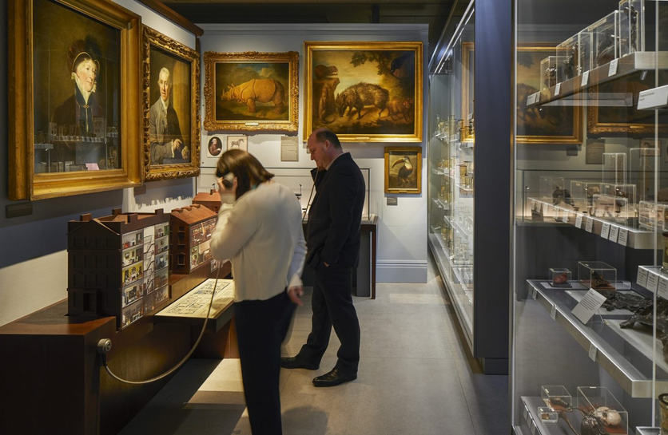
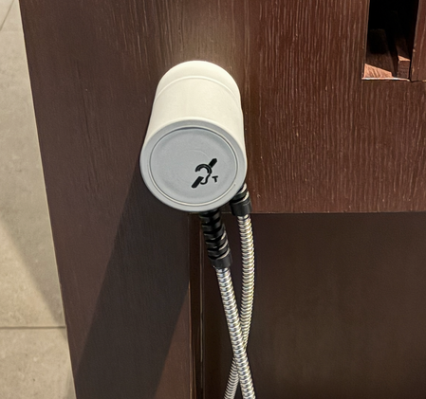
John Hunter – Leicester Square
In 1783, John and his wife Anne moved to a new home at Leicester Square.
You can use the device to hear Hunter’s housekeeper showing two visitors through Hunter’s House.

Slide 14
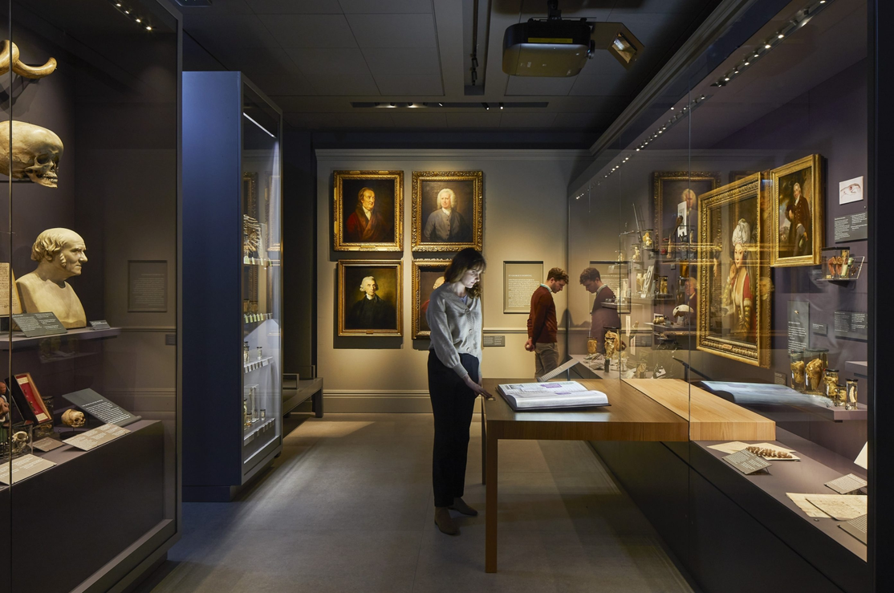

John Hunter – St George’s Hospital
John Hunter served as a surgeon at London’s St George’s Hospital for 25 years.
This room tells the stories of John Hunter’s patients.

Slide 15
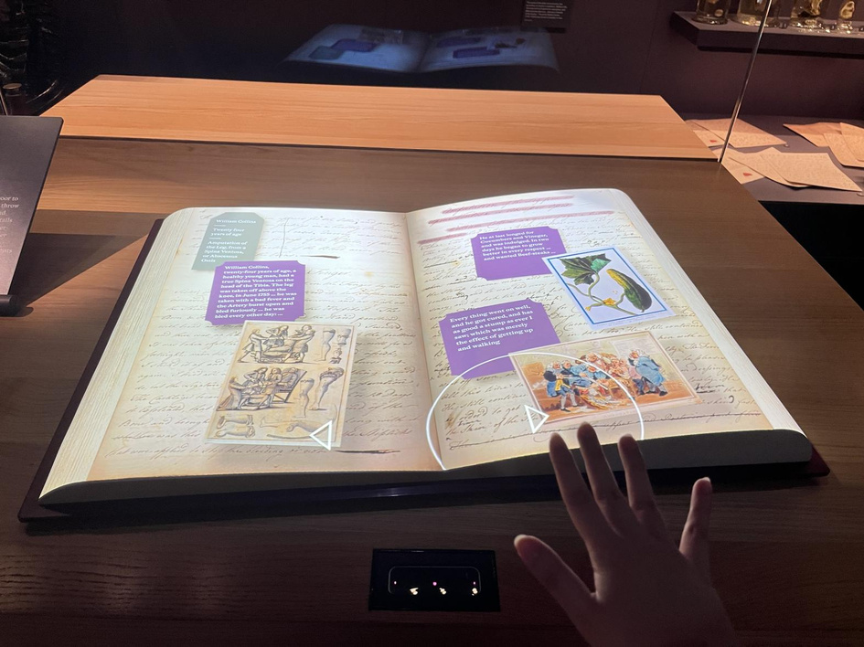
You can read Hunter’s patient notes by hovering your hand over arrows on the table.

Slide 16
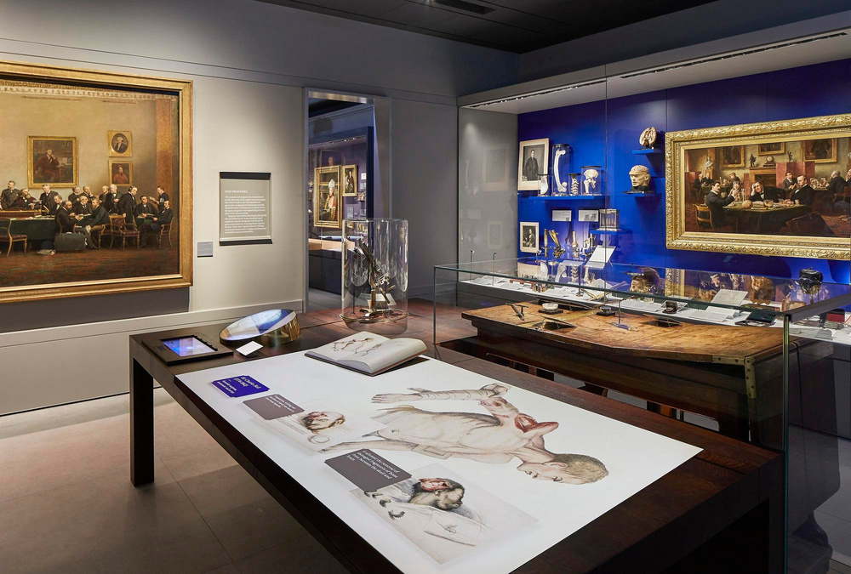

New Frontiers Gallery
This room showcases medical discoveries from 1800 to 1900.
It shows pain relief, killing germs and new ways to operate on the body.

Slide 17
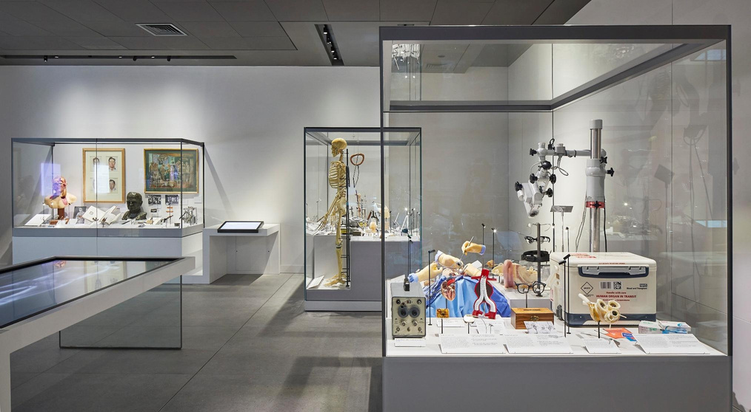
Modern Surgery Gallery
This room looks at scientific development of medicine from the First World War (1914) until now.
This room has videos showing real surgery.

Slide 18
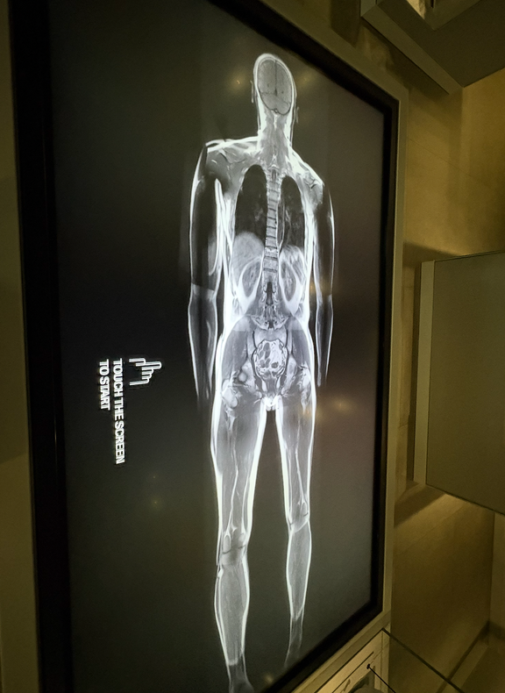
Modern Surgery Gallery
There is also a touch screen monitor in the center of the room, you can use it to explore more about the human body.

Slide 19
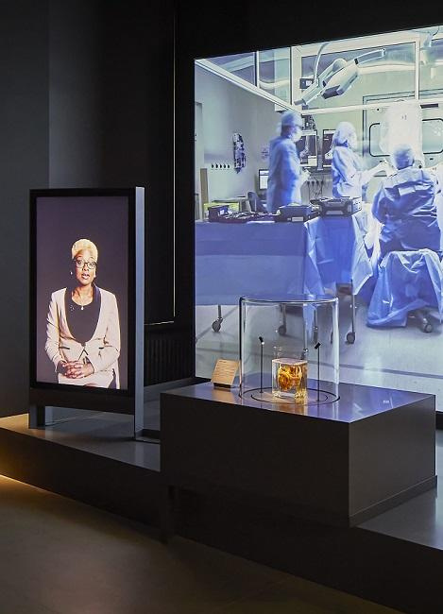



Transforming lives
You can watch videos about stories of patients and surgeons.
A human heart is on display.
The videos might be a bit loud.

Slide 20
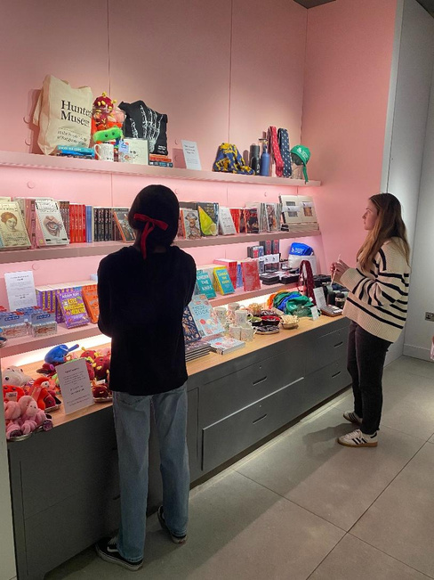
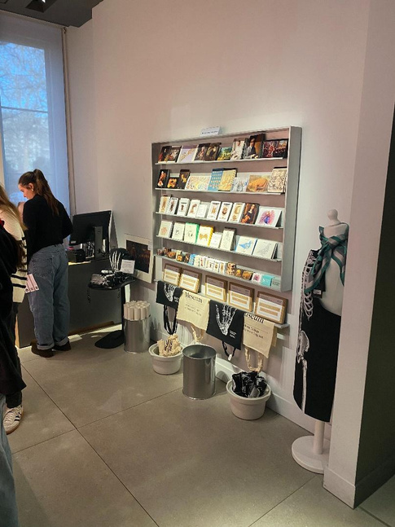
The shop
The shop is open during museum hours.
The shop accepts card payments only.

